Slide 1
CSET301 – AI-ML
Lecture 1: Designing a learning system

Slide 2
Overview
Course Code: CSET301
Course Title : Artificial Intelligence and Machine Learning
Course Credits: 5
Course L-T-P : 3-0-4

Slide 3
Overview
Course Outcomes:
CO1 | Explain the fundamental concepts of Artificial Intelligence and its various approaches
CO2 | Understand and apply supervised, unsupervised, and reinforcement learning techniques to solve real-world problems.
CO3 | Implement basic machine learning algorithms such as linear regression, logistic regression, decision trees, and clustering techniques using programming tools.
CO4 | Analyze and compare the performance of various machine learning models using appropriate evaluation metrics
CO5 | Design and develop AI/ML-based solutions for classification, prediction, and optimization problems in various domains.
CO6 | Evaluate the ethical implications, limitations, and societal impact of AI and ML technologies.

Slide 4
Overview
Course Evaluation Scheme
Course Components | Distribution
Lab (Practical + Hackathon): | 30
Certification | 10
Mid Semester Examination | 15
End Semester Examination | 40
Quiz | 5
Total | 100

Slide 5
Overview
Course Resources:
Text Books:
1. Mitchell, Tom M. Machine Learning. 1st ed. McGraw Hill, 2017. ISBN 978-1259096952.
2. Alpaydin, Ethem. Introduction to machine learning. 4th ed. Phi, 2020. ISBN 978-8120350786.
Reference Books:
1. Campesato, Oswald. Artificial intelligence, machine learning, and deep learning. 1st ed. Mercury Learning and Information, 2020. ISBN 9781683924665.

Slide 6
Overview
Course Certification:
Certification (Do any one of these three courses): Min Hours: 24 hours
Advanced Learning Algorithms (32 hours)
https://www.coursera.org/learn/advanced-learning-algorithms?specialization=machine-learning-introduction
OR
Unsupervised Learning, Recommenders, Reinforcement Learning (27 hours)
https://www.coursera.org/learn/unsupervised-learning-recommenders-reinforcement-learning?specialization=machine-learning-introduction
OR
NPTEL Course: Introduction to Machine Learning – IITKGP (noc25-cs149)
By Prof. Sudeshna Sarkar (IIT Kharagpur)
Duration: 8 weeks
Start Date: 21st July 2025, End Date: 12 September 2025, Proctored Exam Date: 21st September 2025
https://onlinecourses.nptel.ac.in/noc25_cs149/preview

Slide 7
Overview of AI-ML
Learning ↔ Intelligence
Learning: Acquisition of knowledge or skills through study, experience, or being taught.
Intelligence is the ability to learn and use concepts to solve problems.
Machine Learning ↔ Artificial Intelligence
Artificial Intelligence (AI): is the science of making machines do things that require intelligence if done by human. (Minsky 1986).
Machine Learning (ML): is an area of AI concerned with development of techniques which allow machines to learn.

Slide 8
Artificial Intelligence (AI)
Intelligence is taking some input data, process it, and make some useful meaningful well-informed decisions based on it. When computers try to do the same, it is known as Artificial Intelligence (AI).
In other words, Artificial Intelligence (AI) is the science of making machines "think" like humans — enabling them to perform tasks such as learning, reasoning, problem-solving, perception, and language understanding
The term Artificial Intelligence was coined in back 1956 by John McCarthy.
But AI has seen sudden boom – thanks to increased data volume, advanced algorithms, increase in computation power and storage.

Slide 9
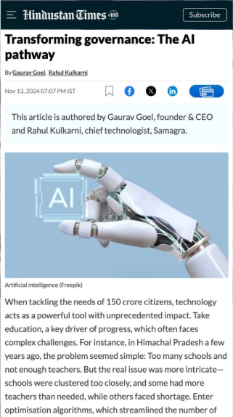


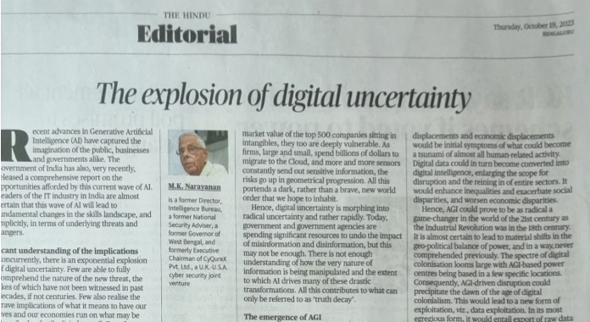
AI is everywhere

Slide 10
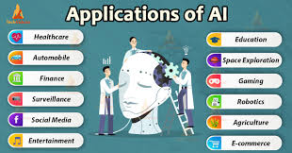
Applications of AI

Slide 11
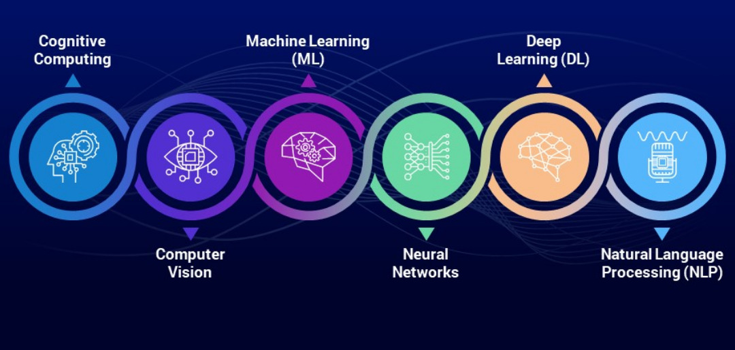
Sub-domains of AI

Slide 12
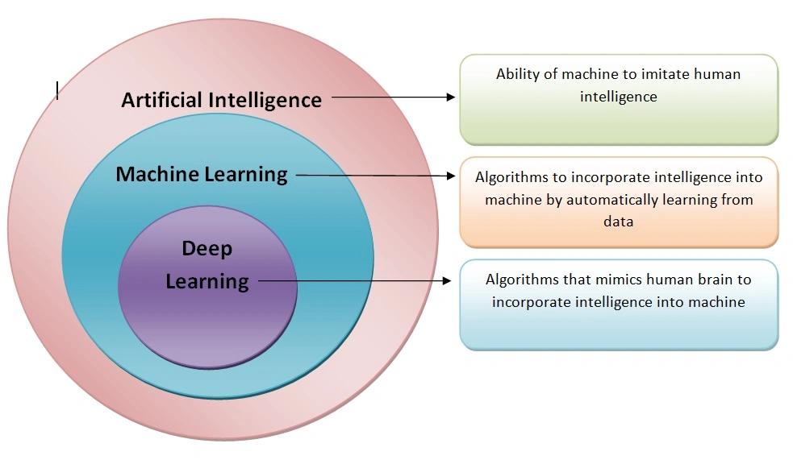
AI vs ML vs DL

Slide 13


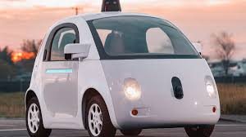

AI use-cases:
Voice Assistants
Google Maps for intelligent navigation
Netflix/Youtube for personalized recommendations
Self driving cars

Slide 14
Well-posed Learning Problems
A well-posed problem has three key elements: a task (what the system should do), a performance measure (how well it does it), and experience (data to learn from).
Well-posed problem (By Jacques Hadamard, 1902):
  In the context of mathematical models, a well posed problem is the one that satisfies three key criteria:
  existence of a solution,
  uniqueness of the solution, and
  continuous dependence of the solution on the problem's data

Slide 15
Well-defined learning problem
Example: Checkers Learning Problem
Task T: playing checkers
Performance measure P: percent of games won against opponents.
Training experience E: playing practice games against itself.

Slide 16
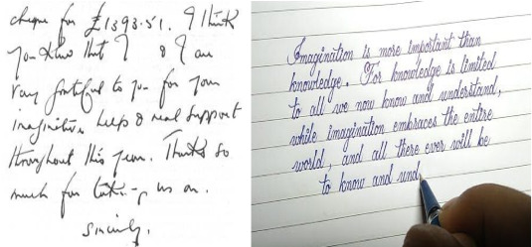
Well-defined learning problem
Example: Handwriting Recognition Learning Problem
Task T: recognizing and classifying handwritten words within images
Performance measure P: percent of words correctly classified.
Training experience E: a database of handwritten words with given classifications

Slide 17
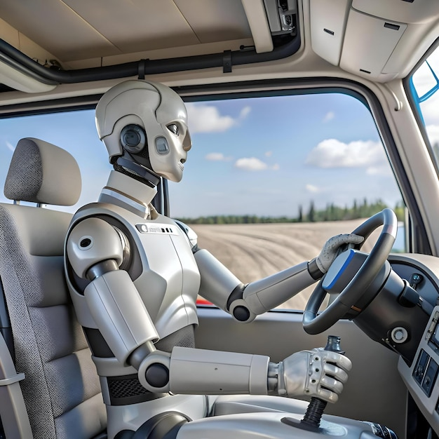
Well-defined learning problem
Example: Robot Driving Learning Problem
Task T: driving on public four-lane highways using vision sensors
Performance measure P: average distance travelled before an error (as judged by human overseer)
Training experience E: a sequence of images and steering commands recorded while observing a human driver.

Slide 18
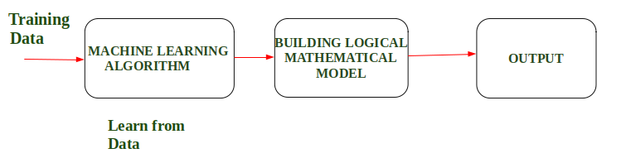
Designing a Learning System
According to Arthur Samuel “Machine Learning enables a machine to automatically learn from Data, improve performance from an Experience and predict things without explicitly programmed.”
In simple words, when we feed the training data to ML algorithm, this algorithm will produce a mathematical model and with the help of this mathematical model, the machine will make a prediction and take a decision without being explicitly programmed.
Also, during training, the more machine will work with it the more it will get experience, and the more efficient result is produced.

Slide 19
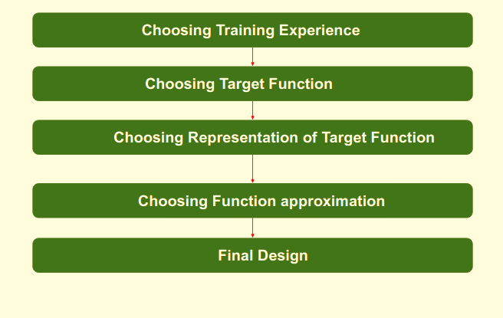
Steps to Design a Learning System

Slide 20
Steps to Design a Learning System
1. Choosing the Training Experience
The first step is to choose the training data which will be fed to the ML algo.
Training data has significant impact on the success or failure of the model, thus it must be chosen wisely.
Attributes of training data which impacts the success of ML model:
  Type of feedback: direct (you get the feedback immediately) and indirect (final outcome depends on sequence of moves)
  Degree of training: Extent upto which a learner can control the sequence of training
  Distribution of samples: More diverse the training data, more robust the model

Slide 21
Steps to Design a Learning System
2. Choosing the target function:
Determine what type of knowledge will be learned and how this will be used by performance program.
Taking the example of checkers game: The program only needs to learn how to select the best move out of the legal moves (Set of all possible moves). In this learning task, all possible moves becomes the large search space which is known apriori but the best search strategy is unknown.

Slide 22
Steps to Design a Learning System
3. Choosing Representation for Target function:
Next step is to generate a function or program that chooses the best move from all possible legal moves.
Function representation can be generated using Linear equations, hierarchical graph representations, etc.
4. Choosing a Function Approximation Algorithm:
An optimized move cannot be chosen just with the training data. The model go through set of training examples and approximates the parameters to finally find the optimized move.

Slide 23
Steps to Design a Learning System
5. The Final Design: The final design is created at last when system goes from number of examples, failures and success, and deciding what will be the next step etc.
Example: DeepBlue is an intelligent computer which is ML-based won chess game against the chess expert Garry Kasparov, and it became the first computer which had beaten a human chess expert.

Slide 24
MACHINE LEARNING
Learning: Changes in a system that enable the system to do the same task more efficiently the next time
Machine Learning: Programming computers to optimize a performance criteria using example data.
Deep Learning: Subfield of machine learning concerned with algorithms inspired by the structure and function of the brain called artificial neural networks.

Slide 25
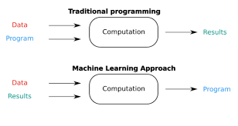
Traditional Programming vs Machine Learning

Slide 26
Machine Learning system: Perspective and Issues
While building ML applications from scratch, few issues could arise:
1. Inadequate Training Data
One of the major issue in building ML algo is the lack of quality as well as quantity of data.
Data plays a vital role in the processing of ML algorithms, many data scientists claim that inadequate data, noisy data, incorrect data and unclean data are extremely exhausting the machine learning algorithms.

Slide 27
Machine Learning system: Perspective and Issues
While building ML applications from scratch, few issues could arise:
2. Non-representative Training Data
Non-representative training data is the one that doesn't accurately reflect the real-world distribution of the data.
This can lead to a model that performs well on the training data but poorly on new, unseen data, a phenomenon known as poor generalization.

Slide 28
Machine Learning system: Perspective and Issues
While building ML applications from scratch, few issues could arise:
3. Overfitting and Underfitting
Overfitting is one of the most common issues faced by ML engineers and data scientists. Whenever a ML model is trained with a huge amount of data, it starts capturing noise and inaccurate data of the training set. It negatively affects the performance of the model in the sense that the model works extremely well on training data but extremely poor on test data.

Slide 29
Thank You

